Slide 1
Human Respiratory System Structures
Respiratory System Unit

Slide 2
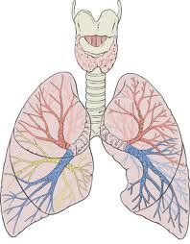
Lungs
-Main organ of the respiratory system.

Slide 3
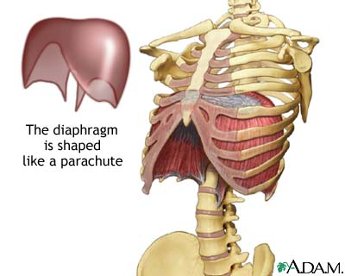
Diaphragm
-Main muscle that controls breathing by changing pressure in the chest cavity when it contracts.
https://www.youtube.com/watch?v=hp-gCvW8PRY

Slide 4
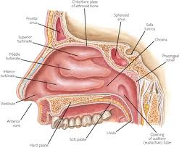
Nasal Cavity/Nose
-Place where air enters the body; warms, moistens, and filters incoming air.

Slide 5
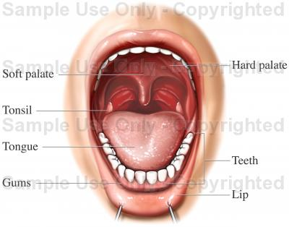
Mouth
-Another place where air enters the body.

Slide 6
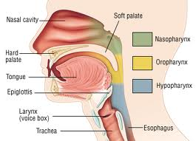
Pharynx
-Common passageway of your nasal cavity and your mouth.

Slide 7
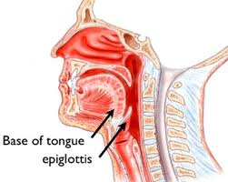
Epiglottis
-Flap that closes over the trachea when swallowing to keep food from “going down the wrong pipe”; remains open when breathing.
https://www.youtube.com/watch?v=qrAfEyane2Y

Slide 8
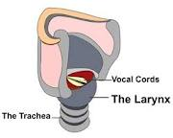
Larynx
-“Voice box”; makes sounds as air passes through vocal cords.
https://www.youtube.com/watch?v=iYpDwhpILkQ

Slide 9
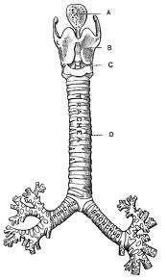
Trachea
-Windpipe; tube leading into the chest cavity.

Slide 10
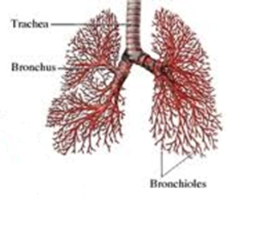
Bronchi
-Branches of the trachea that lead to each lung.

Slide 11
Bronchioles
-Smaller branches of the bronchi inside the lungs.

Slide 12
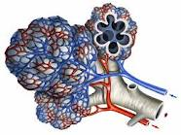
Alveoli
-“Grapelike”, Tiny, thin walled sacs where oxygen and carbon dioxide are exchanged.

